Slide 1

ADITYA COLLEGE OF ENGINEERING AND TECHNOLOGY
DEPARTMENT OF CSE-AIML
A Project Presentation on
REPLIMATE
AI – POWERED PERSONAL DIGITAL TWIN
Presented by
Kone Veera Sravani (22P31A4299)
Korukonda Chiranjeevi Mani Vinayak (23P35A4209)
Kondela Prasanna Kumar (22P31A4298)
Adduri Harsha Vardhan (22P31A4265)
Dwarapudi Srinu (22P31A4280)
Under the Guidance of
Ms.Y.Chandini, M.Tech.,
Assistant Professor
DEPARTMENT OF CSE-AIML

Slide 2
CONTENTS
Abstract
Problem Statement
Introduction
Utility of the Problem
Motivation Behind Problem Selection
Literature Survey
Existing System and Disadvantages
Proposed Solution and Analysis
Merits / Demerits of Proposed Solution
Functional Requirements
Non-Functional Requirements
Feasibility Study
Modules
System Architecture
UML Diagrams
Progress of Implementation
Test Cases
Output Screens
Basic Output and Result Analysis
Scope of the Project
Conclusion and Future Enhancements
References

Slide 3
ABSTRACT
Replimate is an AI-powered assistant that learns a user’s personality, behavior, and communication style. It remembers preferences, manages reminders, summarizes notes, and provides personalized suggestions for education, work, and health, helping improve productivity and daily life.
The system ensures complete data safety using AES-256 encryption, federated learning, and differential privacy. This keeps all personal information private and under user control while allowing Replimate to grow smarter and more personalized over time.

Slide 4
PROBLEM STATEMENT
People use many digital apps every day, but these systems don’t truly understand their habits, emotions, or preferences. As a result, users face repetitive tasks, lack of personalization, and risk of data misuse. Existing AI assistants can help with simple queries but cannot provide secure, personalized experiences. Therefore, there is a need for an AI powered personal digital twin that can learn from the user, adapt to their behavior, and protect their personal data at the same time.

Slide 5
INTRODUCTION
Replimate is an AI-powered personal digital twin designed to understand and replicate a user’s personality, behavior, and communication style.
It continuously learns from user interactions to provide highly personalized assistance in daily tasks, education, and professional work.
The system uses advanced Machine Learning and Large Language Models to communicate naturally and intelligently with users.
Replimate can manage reminders, summarize notes, track preferences, and offer smart recommendations tailored to individual needs.
User privacy is a top priority, ensured through AES-256 encryption, federated learning, and differential privacy techniques.
The project aims to create a secure, evolving AI companion that grows with the user and enhances productivity, learning, and everyday life.

Slide 6
UTILITY OF THE PROBLEM
Provides a personalized digital assistant that understands and adapts to the user.
Helps in managing daily tasks, reminders, and learning activities efficiently.
Improves productivity and emotional well-being through intelligent suggestions.
Ensures data privacy and security using AES-256 encryption.

Slide 7
MOTIVATION BEHIND PROBLEM SELECTION
Existing AI systems like Siri, Alexa, and Google Assistant provide only surface-level assistance and do not learn from a user’s personality or history. Recent research in digital twins, federated learning, and LLMs (e.g., OpenAI GPT, IBM Granite) has demonstrated the potential for deeper personalization but lacks secure personal memory systems.
The motivation behind Replimate arises from bridging this gap — to design an AI that acts as an extension of Self while ensuring data privacy, ethical learning, and emotional intelligence. The literature survey indicates limited implementations combining these aspects, highlighting strong research potential and societal relevance.

Slide 8
LITERATURE SURVEY
S.No | Title | Publication & Year | Observations | Limitations
1. | Retrieval-Augmented Generation for Knowledge-Intensive NLP Tasks | NeurIPS, 2020 | Introduced RAG models that combine retrieval mechanisms with generative transformers to improve factual and context-based responses. Useful for building memory-aware AI assistants. | Retrieval depends heavily on document quality and requires large-scale indexing for efficiency.
2. | Attention Is All You Need | NeurIPS, 2017 | Proposed the Transformer architecture using self-attention, enabling better language understanding and sequence modeling. Foundation for modern LLMs. | Requires high computational resources and large datasets for training effectively.
3. | BERT: Pre-training of Deep Bidirectional Transformers for Language Understanding | NAACL-HLT, 2019 | Developed a bidirectional transformer model for deep contextual language understanding, improving NLP tasks like classification and question answering. | BERT is not generative and requires fine-tuning for specific tasks and personalization.
8

Slide 9
S.No | Title | Publication & Year | Observations | Limitations
4. | Language Models Are Few-Shot Learners (GPT-3) | NeurIPS, 2020 | Demonstrated that large language models can perform tasks with minimal examples, enabling adaptive conversational AI systems. | High model size makes deployment expensive and raises concerns of privacy and hallucinations.
5. | Dense Passage Retrieval for Open-Domain Question Answering | EMNLP, 2020 | Proposed dense embedding-based retrieval for improving question answering by fetching relevant passages efficiently. Supports memory retrieval in digital twin systems. | Requires large training data and may fail in highly personalized or private datasets.
6. | Differential Privacy for Deep Learning | ACM CCS, 2016 | Proposed privacy-preserving learning by adding noise to gradients, preventing leakage of sensitive user data. | Noise addition may reduce model accuracy if not tuned properly.

Slide 10
EXISTING SYSTEM
AI Assistants (Siri, Alexa):Voice-based virtual assistants that perform basic tasks like answering queries, setting reminders, and controlling smart devices, but offer limited personalization and emotional understanding.
AI Chat Models (Gemini, ChatGPT):Text-based conversational systems that provide intelligent responses and information, but do not maintain long-term personalized user profiles or adaptive behavior.
Digital Cloning and Avatar Platforms: Systems that create virtual representations of users using stored data or media, but lack continuous learning, deep intelligence, and secure behavioral modeling.

Slide 11
DISADVANTAGES OF THE EXISTING SYSTEM
Limited personalization
Generic replies
Poor emotion understanding
Privacy risks
Data security issues
No long-term memory
Not context-aware
No learning from user habits
Repeat same answers
Depends heavily on cloud

Slide 12
PROPOSED SOLUTION
The proposed solution presents an AI-powered architecture designed to deliver secure and personalized user interactions.
The user accesses the system through a Frontend UI, which communicates with the backend via an API Gateway.
An encryption layer ensures data privacy and secure transmission.
A memory retrieval module helps retain user context to enhance personalization over time.
This information is then passed to a Large Language Model (LLM) for intelligent reasoning and response generation.
Finally, the system delivers accurate, context-aware, and personalized outputs to the user, creating an efficient and adaptive user experience.

Slide 13
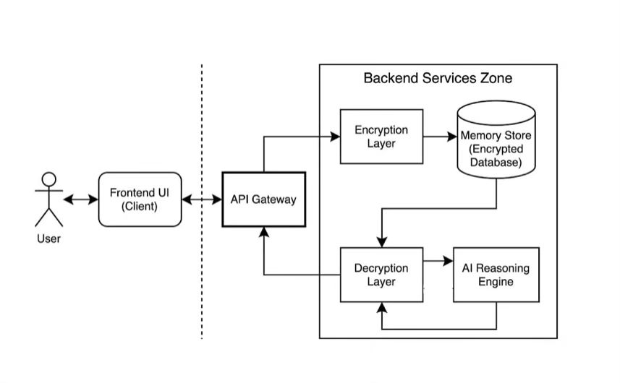
Proposed Solution

Slide 14
ANALYSIS OF THE PROPOSED SOLUTION
The proposed system uses an AI-based architecture to provide personalized assistance.
User Interaction Analysis: Understands user preferences and communication style from conversations.
Memory Retrieval: Retrieves stored user data to provide personalized responses.
Context Understanding: Uses NLP to understand the meaning and intent of user queries.
Response Generation: Uses a Large Language Model (LLM) to generate intelligent responses.
Knowledge Retrieval (RAG): Retrieves relevant information from stored data to improve accuracy.
Security Management: Protects user data using secure authentication and encryption.

Slide 15
MERITS / DEMERITS OF PROPOSED SOLUTION
Merits:
Provides personalized AI responses based on user preferences.
Maintains conversation history for context-aware interactions.
Improves productivity through reminders and smart assistance.
Secure authentication and protected user data.
Scalable system that can be extended with new AI features.
Demerits:
Response accuracy depends on the performance of the language model.
Requires higher computational resources for AI processing.
Initial setup and integration of AI models may be complex.
Managing long-term user memory may increase storage complexity.
Response time may increase when processing complex queries.

Slide 16
FUNCTIONAL REQUIREMENTS
Personalized User Interaction: The system adapts responses based on each user’s preferences and behavior.
Emotion Detection: The system identifies user emotions from text and responds empathetically.
Task and Reminder Management: The system allows users to create, update, and receive reminders for tasks.
User Profile Management: The system stores and manages user details, preferences, and history securely.
Notifications and Alerts: The system sends timely alerts for reminders, updates, and important events.
Context-Aware Conversation: The system remembers past interactions to provide meaningful and relevant responses.

Slide 17
NON-FUNCTIONAL REQUIREMENTS
Non-functional requirements for “Replimate : AI-Powered Personal Digital Twin” ensure that the system is not only intelligent but also secure, reliable, and user-friendly. The system must deliver fast and personalized responses, protect user privacy, and adapt smoothly to different users while remaining easy to maintain and scale.
For the Replimate - AI Powered Personal Digital Twin, Non-Functional Requirements focus on:
Scalability : Supports many users smoothly
Availability : Works anytime with low downtime
Usability : Simple and user-friendly interface
Maintenance : Easy to update and manage
Security : Strong data protection and privacy
Performance : Fast and responsive system

Slide 18
FEASIBILITY STUDY
A RepliMate feasibility study examines whether building an AI-powered personal digital twin is practical and effective. It evaluates the system’s technical capability to learn user behavior, ensure privacy, and generate intelligent responses, along with the cost, usability, and real-world deployment needs.
A feasibility study involves three types:
Technical Feasibility:
Checks availability of AI models, RAG techniques, encryption methods, and system architecture needed to build Replimate.
Operational Feasibility:
Ensures the system is easy to use, integrates smoothly into daily life, and meets user needs for personalization and privacy.
Economic Feasibility:
Evaluates development and deployment cost, using open-source tools and cloud services to keep the system affordable.

Slide 19
MODULES
1. User Authentication Module:
User signup and login
Secure password hashing (bcrypt)
Session handling per user
2. User Profile & Memory Module:
Stores user preferences (likes, dislikes, style)
Auto-learning from conversations
Maintains long-term personalized memory
3. Chat Session Management Module:
Create new chat sessions
Maintain multiple chats per user
Load previous chat history
Sidebar-based chat navigation

Slide 20
4. RAG (Retrieval-Augmented Generation) Module:
Loads user memory documents
Converts data into vector embeddings
Retrieves relevant information
Enhances LLM responses with context
5. Backend API Module:
Built using FastAPI
Handles authentication, chat, memory APIs
Manages request–response flow

Slide 21
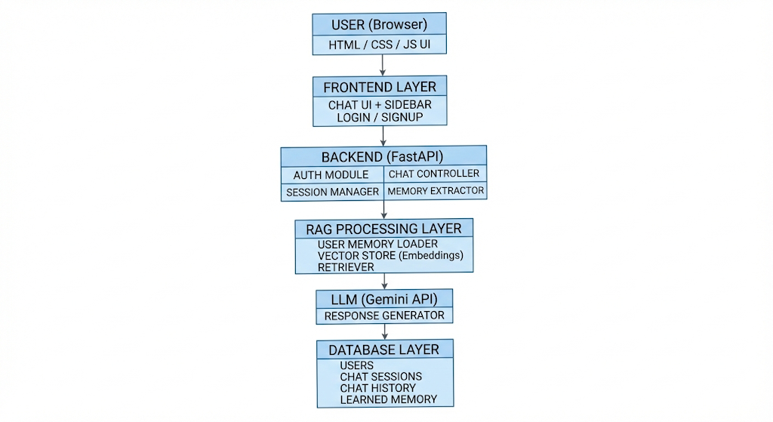
SYSTEM ARCHITECTURE
Fig 1: Architecture for Replimate - AI Powered Personal Digital Twin

Slide 22
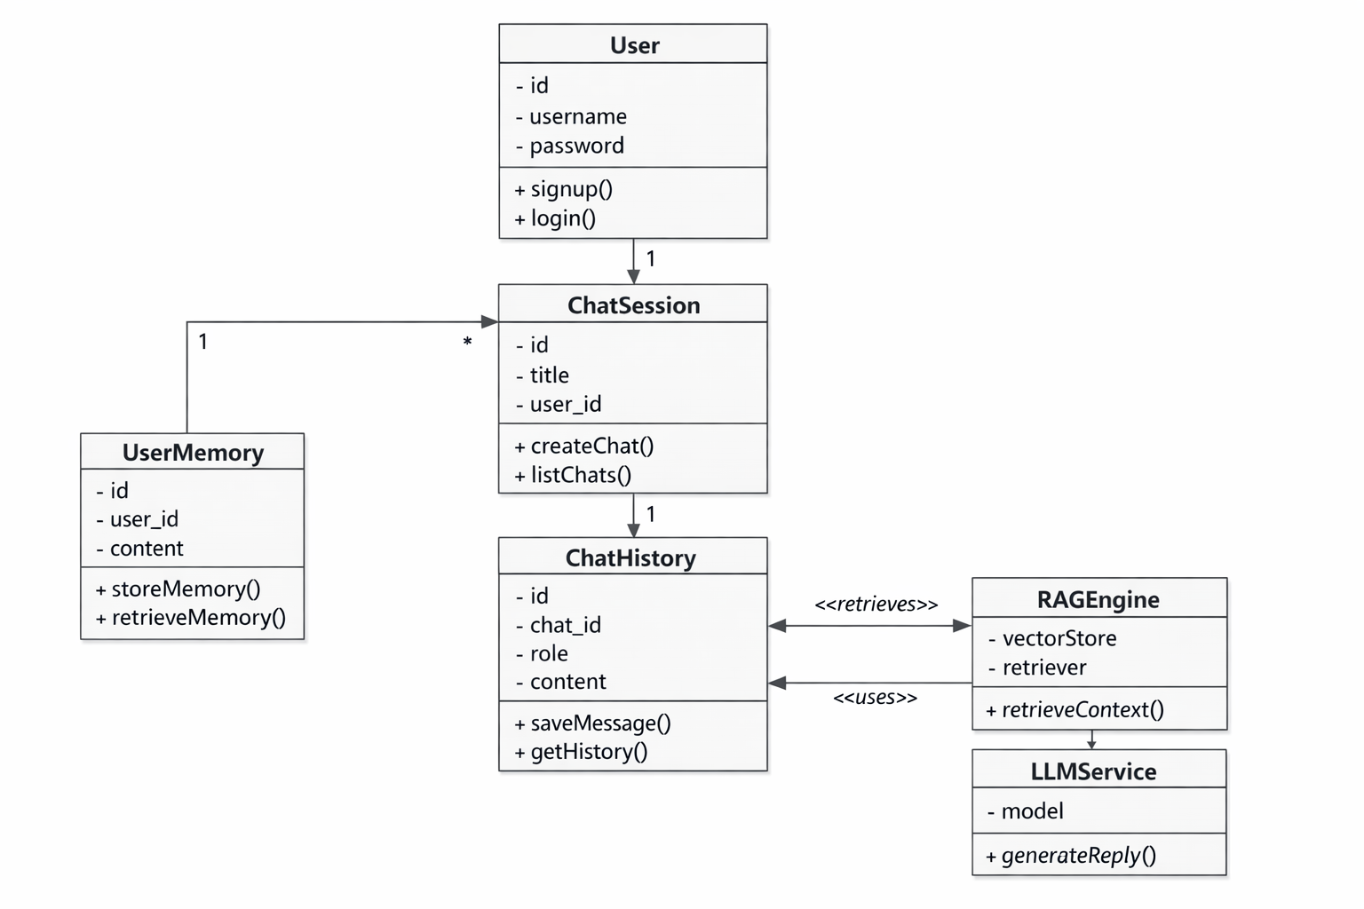
CLASS UML DIAGRAM
Fig 2: Class UML Diagram for Replimate-AI Powered Personal Digital Twin

Slide 23
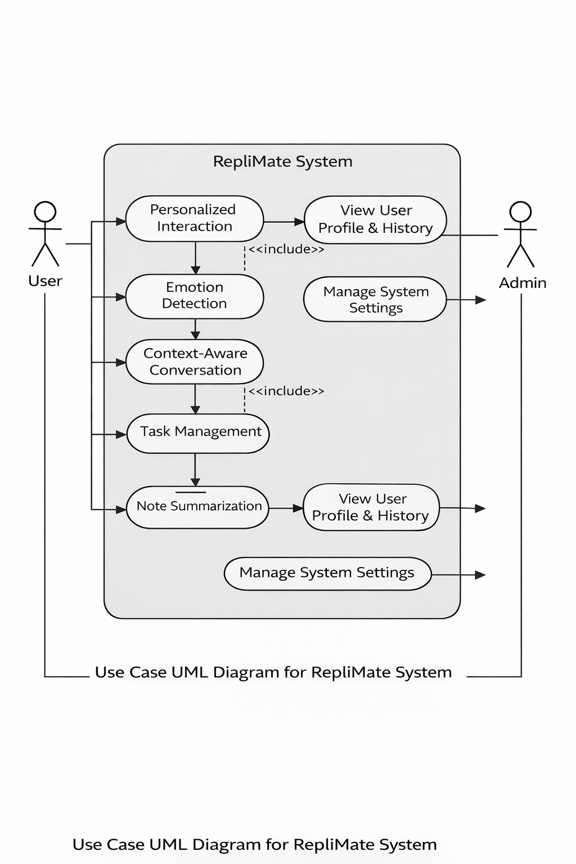
USE CASE DIAGRAM
Fig 3: Use Case Diagram for Replimate-AI Powered Personal Digital Twin

Slide 24
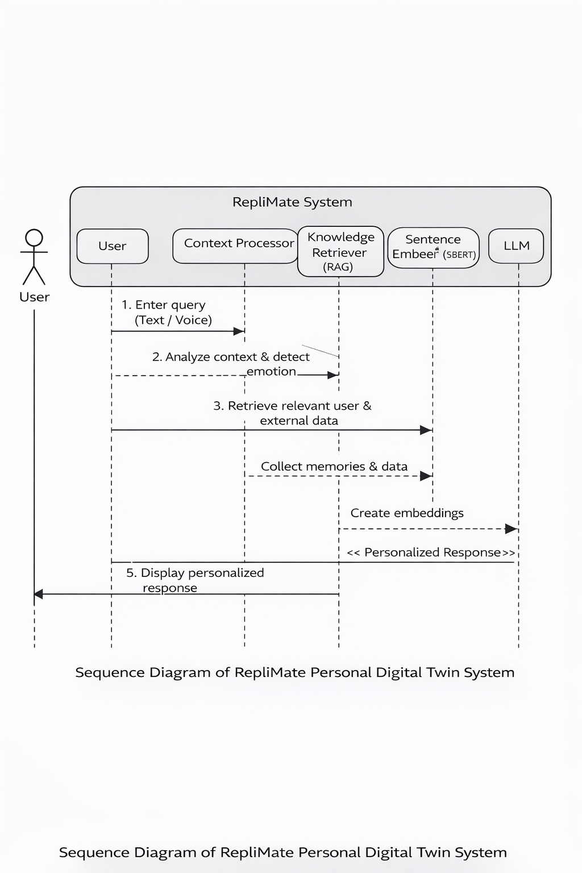
SEQUENCE DIAGRAM
Fig 4: Sequence Diagram for Replimate-AI Powered Personal Digital Twin

Slide 25
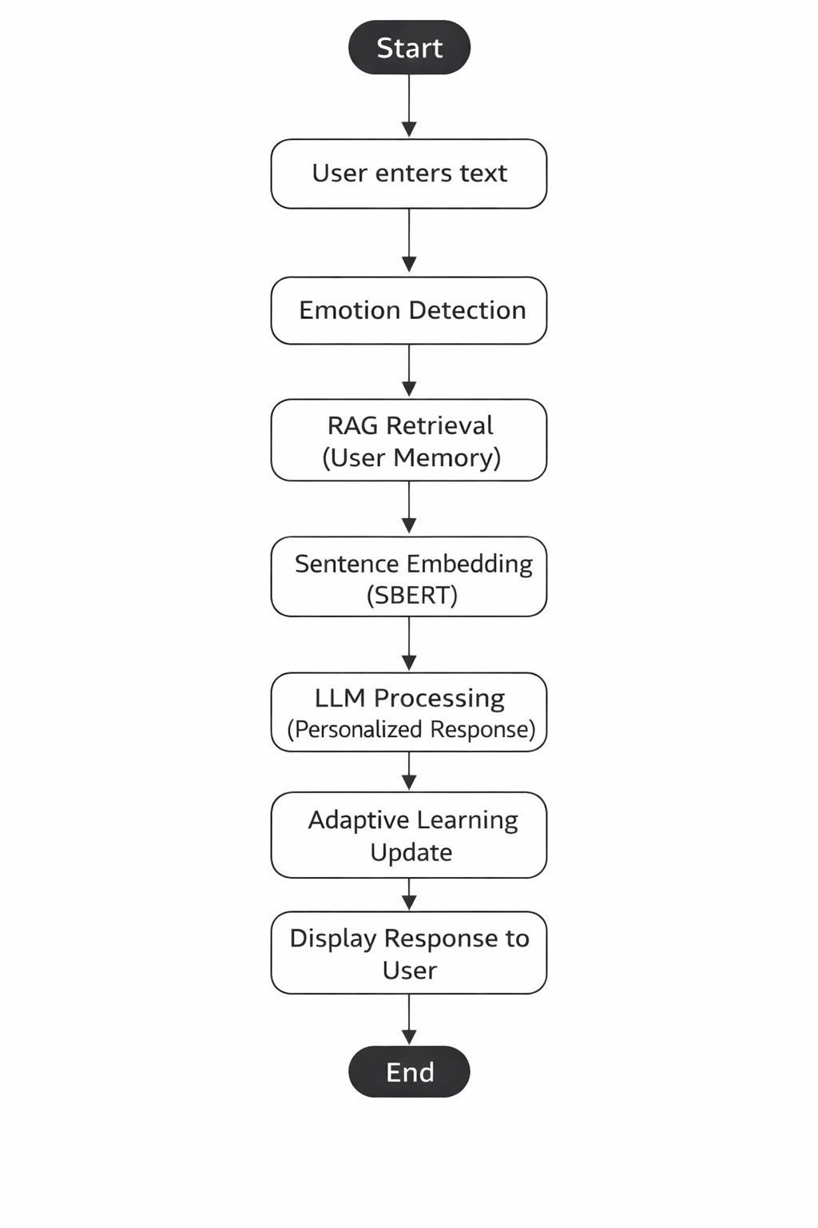
ACTIVITY DIAGRAM
Fig 5: Activity Diagram for Replimate-AI Powered Personal Digital Twin

Slide 26
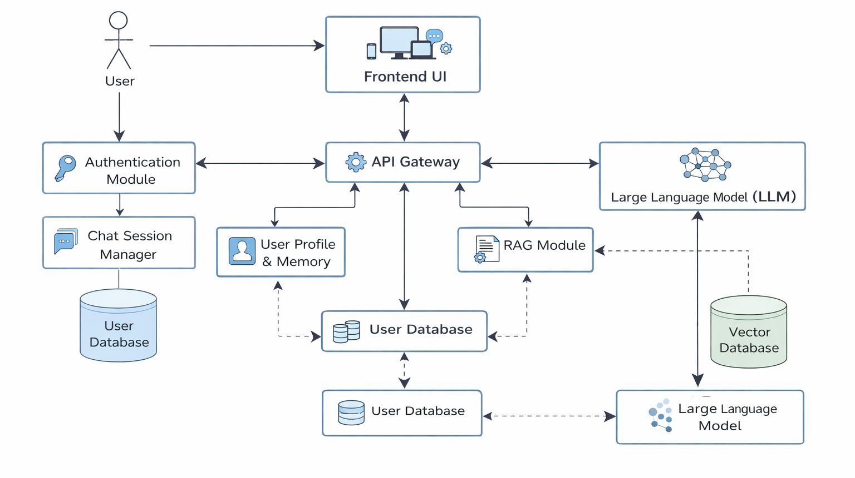
COMPONENT DIAGRAM
Fig 6: Component Diagram for Replimate - AI Powered Personal Digital Twin

Slide 27
PROGRESS OF THE IMPLEMENTATION
The project implementation has progressed through several stages.
Completed Work:
Literature survey and problem identification.
System architecture design.
UML diagrams creation.
User authentication module.
Chat interface development
Backend API development using FastAPI.
Integration with LLM for response generation.
Basic memory storage system
Current Status:
Implementing RAG for personalized responses
Improving memory retrieval system
Testing chat sessions and history storage

Slide 28
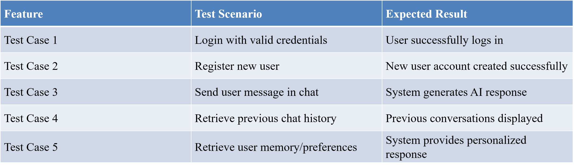
TEST CASES IDENTIFICATION
These are the test cases identified
Fig 6: Test Cases for User

Slide 29
TESTING
Types of Testing Conducted:
Functional Testing:
Verified login system.
Checked chat and memory modules.
Integration Testing:
Testing interaction between frontend and backend
Performance Testing:
Checking response time of the system.
Security Testing:
Ensuring encrypted data handling and secure authentication.

Slide 30
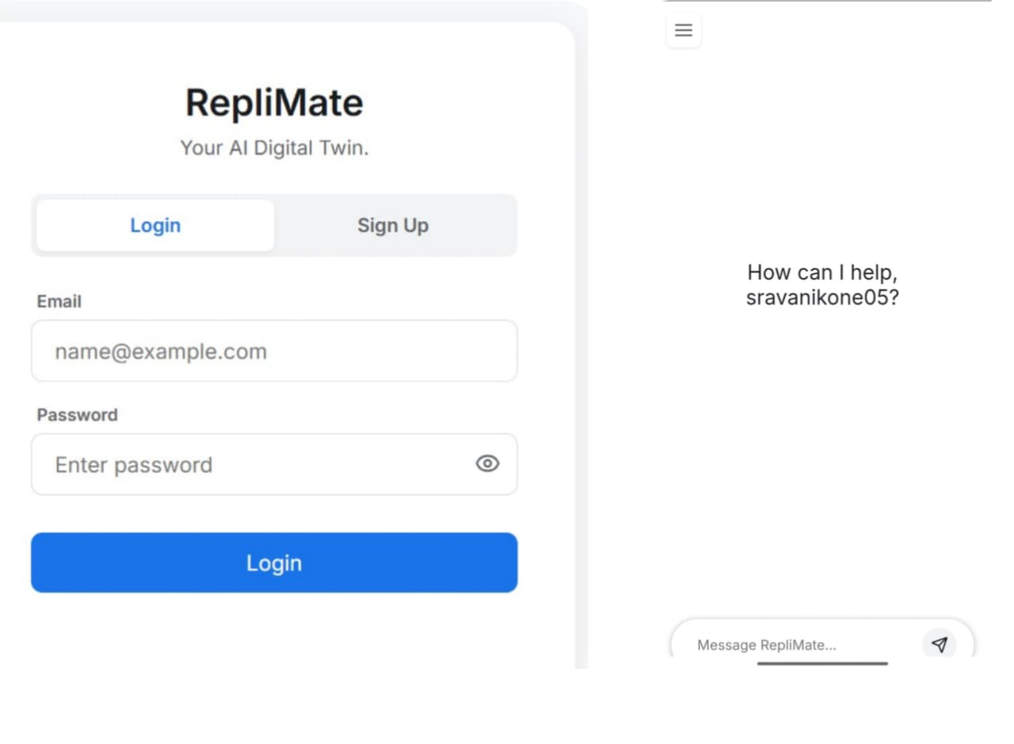
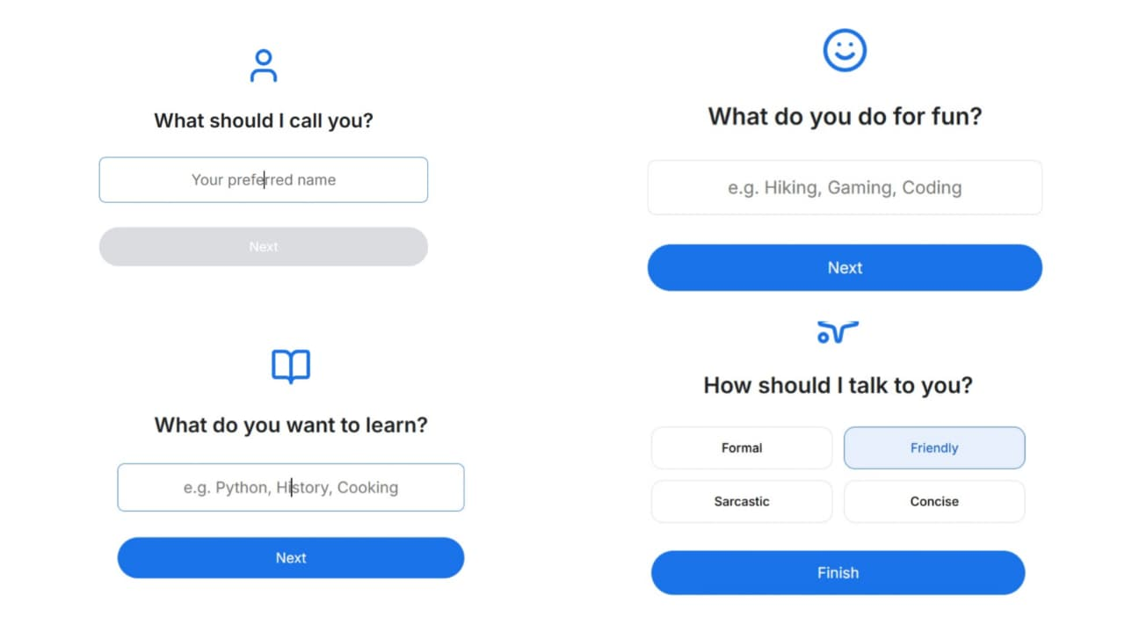
OUTPUT SCREENS
Fig 7: Replimate Login and User Authentication Interface
Fig 8: User Personalization Interface

Slide 31
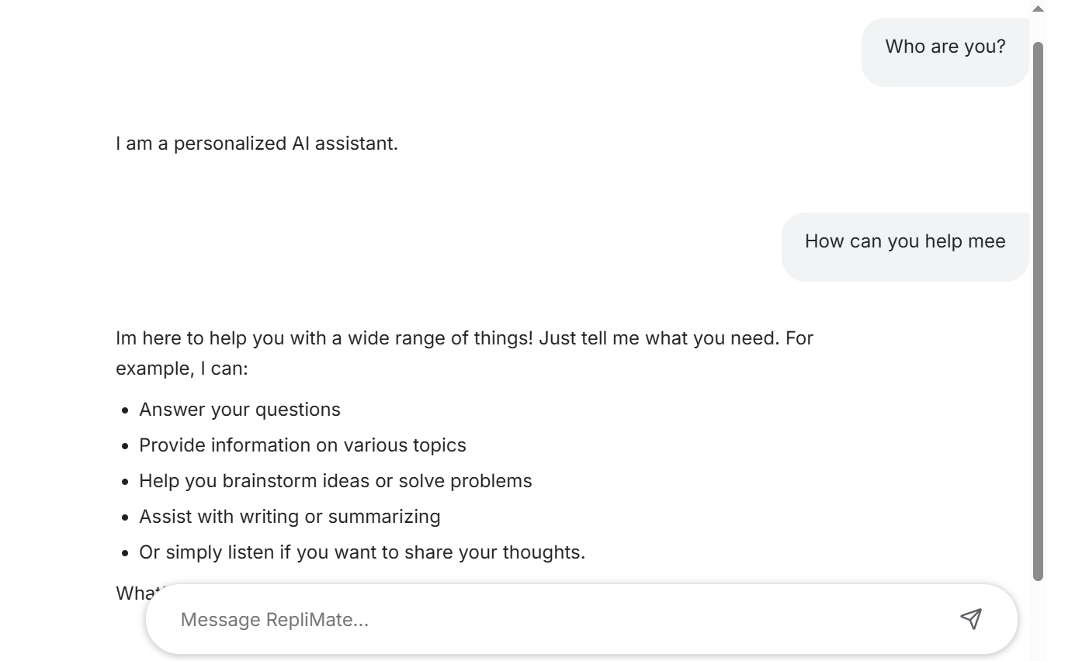
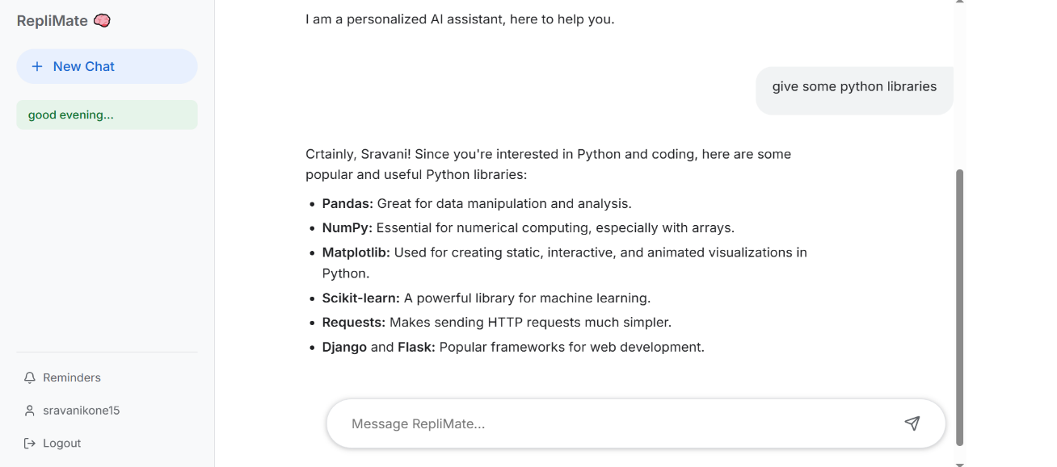
Fig 9: Replimate AI Assistant Interaction Interface
Fig 10: Replimate Output Response with Personalized Suggestions

Slide 32
BASIC OUTPUT AND RESULT ANALYSIS
Basic Output:
The Replimate system analyzes user interactions to provide personalized AI assistance. It processes user queries, retrieves relevant memory, and generates intelligent responses through the chatbot interface.
The system provide the following outputs:
User Authentication Success – The system verifies user credentials and allows secure login and access to the application.
Personalized AI Response – The system generates intelligent and context-aware responses based on the user query.
Memory-Based Suggestions – The system retrieves stored user preferences and previous conversations to provide personalized responses.
Chat History Display – The system stores and displays previous conversations for better context and continuity.

Slide 33
When user interactions occur, the system processes the request through the backend APIs and LLM, generates responses, and stores conversation history in the database. The results are displayed through the chat interface for the user.
Result Analysis:
The Replimate system was tested with different user queries and interaction scenarios to evaluate system performance and response quality.
Observations are
The system successfully authenticates users and manages login sessions.
The chatbot generates relevant and context-aware responses using the language model.
Memory retrieval improves personalization by using stored user preferences.
Chat history allows users to review previous conversations.
The system provides quick responses and smooth interaction through the interface.

Slide 34
SCOPE OF THE PROJECT
Present Scope:
Personal productivity assistant
Personalized learning support
Reminder and task management
Context-aware chatbot systems
Smart digital companion
Future Scope:
Integration with mobile applications
Voice-based interaction
Emotion-aware responses
Cloud-based deployment.

Slide 35
FUTURE WORK
Long-Term Memory Embeddings
Convert learned user preferences into vector embeddings and store them in the vector database for deeper personalization.
Multiple Chat Sessions Management
Add advanced chat session handling with automatic chat titles and session summaries.
Streaming Responses
Implement real-time token-by-token response streaming to improve user experience.
Scalability & Deployment
Deploy the system on cloud platforms such as AWS, Render, or Azure with Docker support.

Slide 36
CONCLUSION
Replimate is an AI-powered personal digital twin designed to provide personalized and intelligent assistance to users. It uses Large Language Models and Retrieval-Augmented Generation (RAG) to deliver accurate and context-aware responses. The system learns from user interactions and stores preferences to improve personalization over time. It integrates features such as user authentication, chat history, and memory management to enhance the user experience. RepliMate ensures data privacy and security while providing meaningful conversations. The system is scalable, efficient, and adaptable for different users. Overall, Replimate demonstrates how modern AI technologies can improve productivity and daily digital interactions.

Slide 37
REFERENCES
[1] Lewis, P., Perez, E., Piktus, A., Et Al.
Retrieval-augmented Generation For Knowledge-intensive NLP Tasks, Advances In Neural Information Processing Systems (Neurips), 2020.
[2] Vaswani, A., Shazeer, N., Parmar, N., Et Al.
Attention Is All You Need,neural Information Processing Systems (Neurips), 2017.
[3] Devlin, J., Chang, M. W., Lee, K., & Toutanova, K.
BERT: Pre-training Of Deep Bidirectional Transformers For Language Understanding,naacl-hlt, 2019.
[4] Brown, T. B., Mann, B., Ryder, N., Et Al.
Language Models Are Few-shot Learners,neural Information Processing Systems (Neurips), 2020.
[5]karpukhin, V., Oguz, B., Min, S., Et Al.
Dense Passage Retrieval For Open-domain Question Answering,emnlp, 2020.

Slide 38
THANK YOU
Department of CSE-AIML , ACET (P3)

